Slide 1


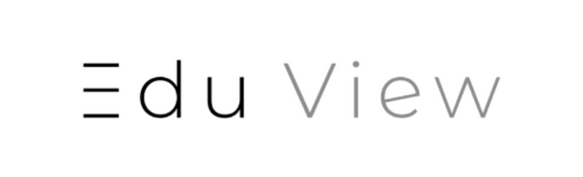

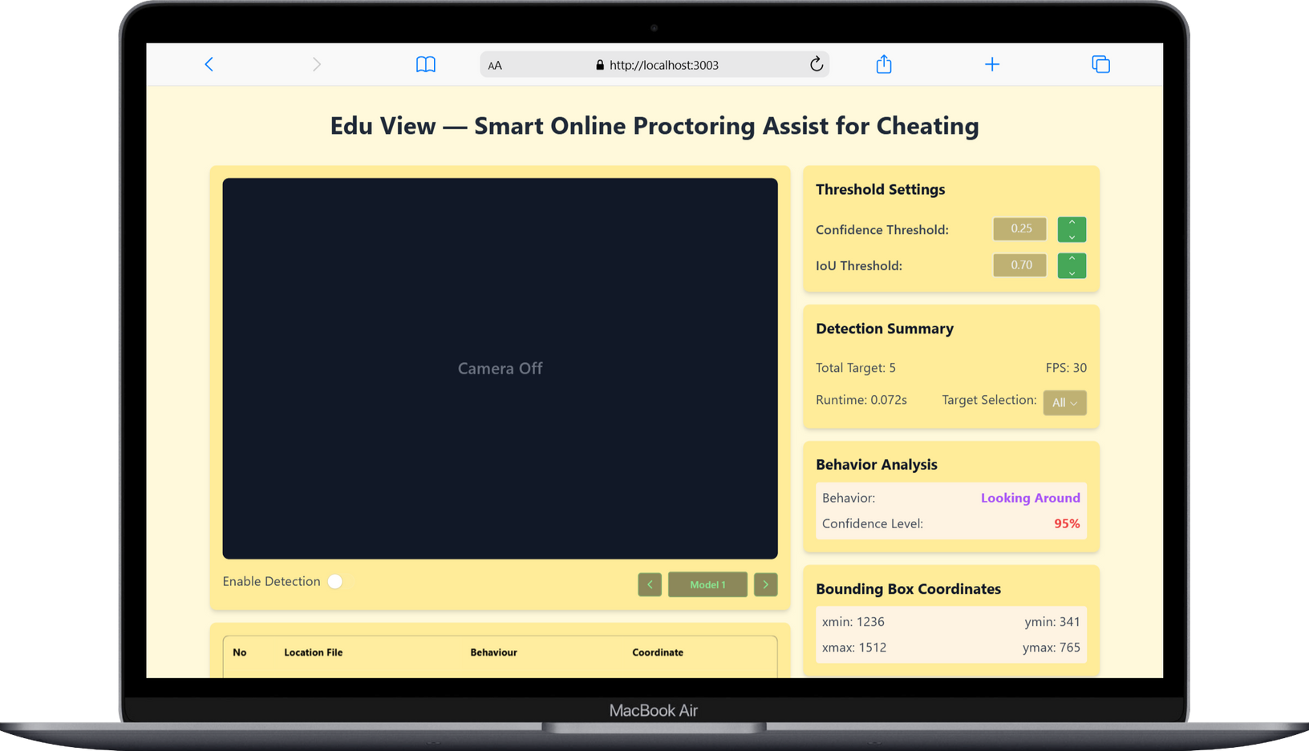
team
one

Slide 2
Anggota kelompok
01
06
E1E122064_LA ODE MUHAMMAD YUDHY PRAYITNO
E1E122032_SUMIARNI MOKA
02
07
E1E122010_DWI PRATIWI APRILYA WAHID
E1E122063_LA ODE ALVIN RAHMAT SAPUTRA
03
08
E1E122099_ICHA ANAWAI
E1E122005_ARTIENTIN
04
09
E1E122110_MUH. FIKRY HAYKHAL
E1E122078_SHERLY DWI PUSPITA
05
10
E1E122090_ARYA DWINATA MUSTAPA
E1E122073_NUZUL GUSTI TIARA FITRI
Present by: LM Yudhy P

Slide 3
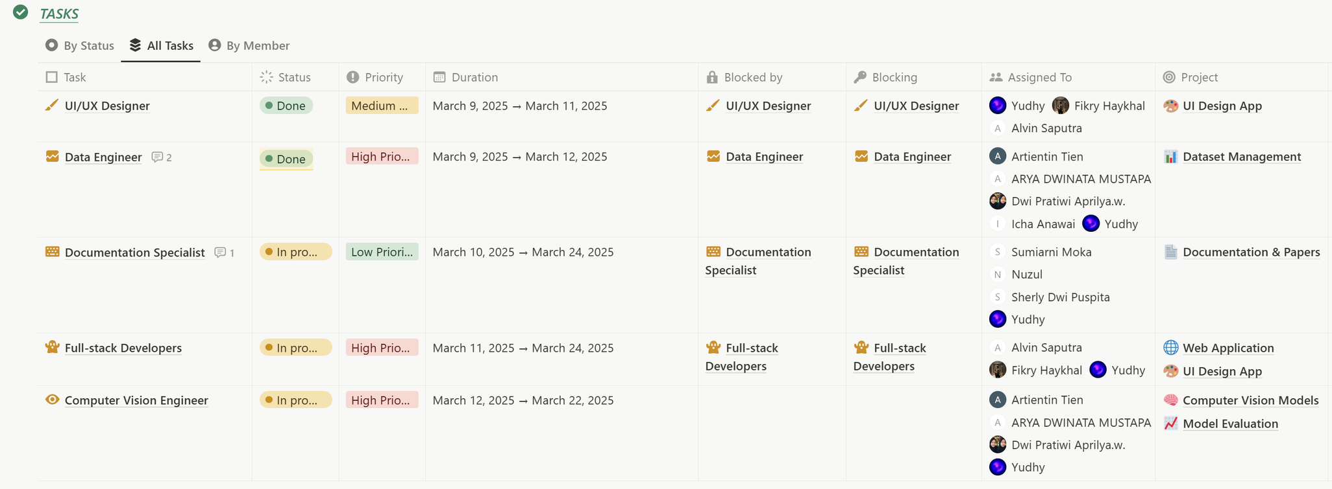
Kanban Project
Present by: LM Yudhy P

Slide 4
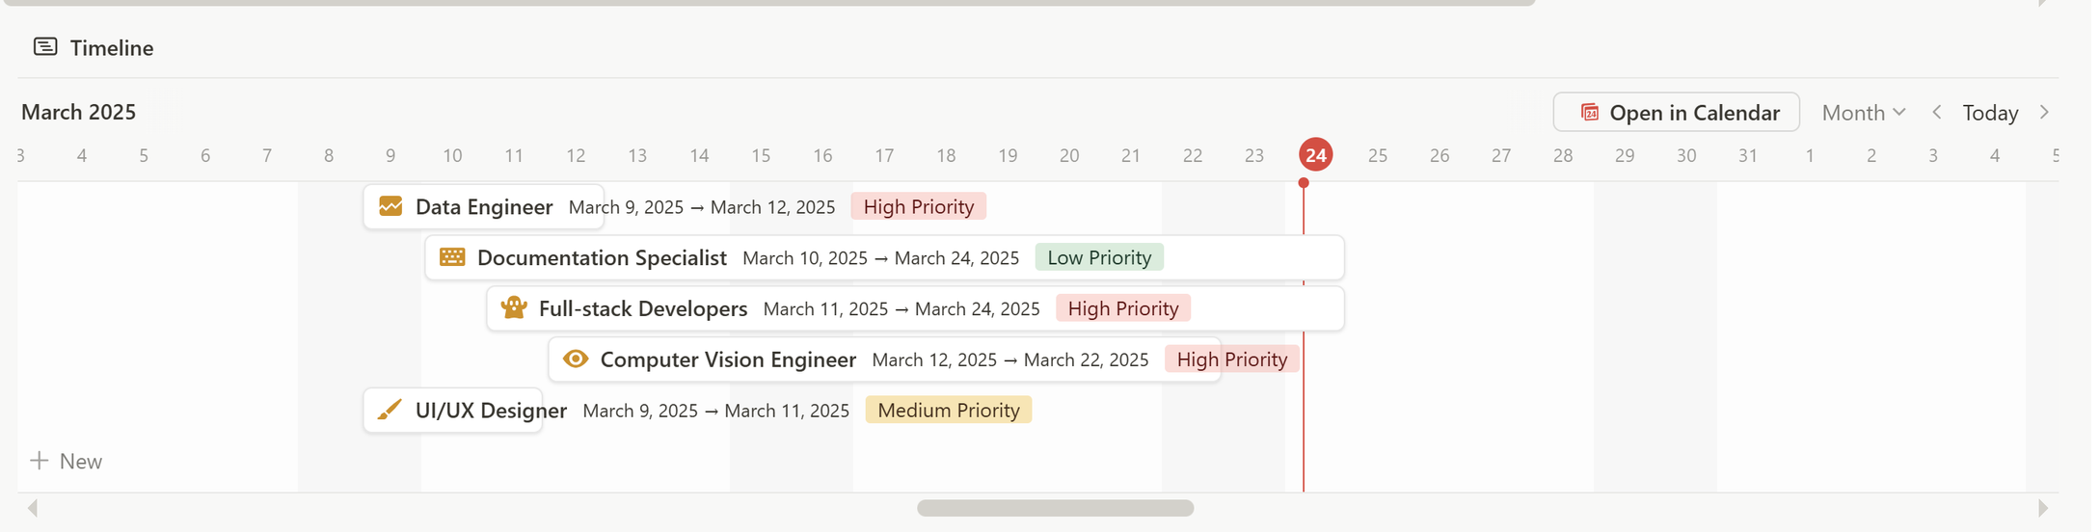
Timeline
Present by: LM Yudhy P

Slide 5
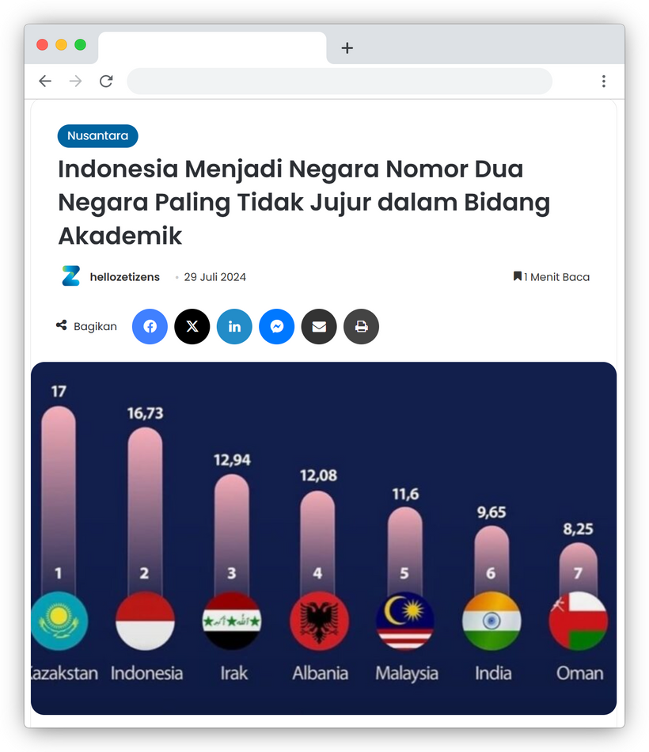


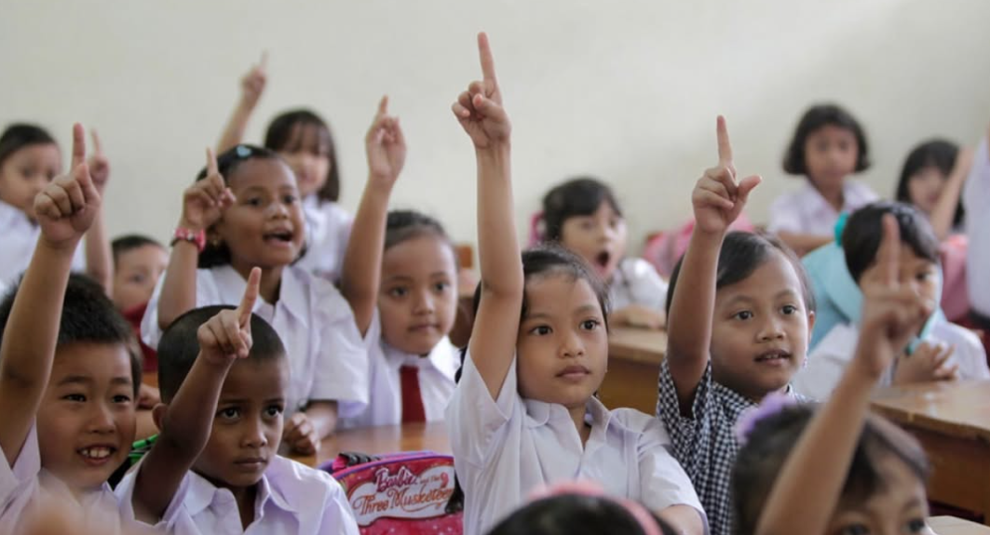
Disclaimer
Education system pressure, result-focused culture, and social environment are the main factors behind dishonesty in Indonesia’s education. The system’s demand for high grades often pushes students and teachers to cheat or manipulate scores. Prioritizing results over understanding makes students choose shortcuts instead of learning honestly. Combined with social norms that overlook academic integrity, this issue continues and is hard to stop.
NEXT
Present by: LM Yudhy P

Slide 6


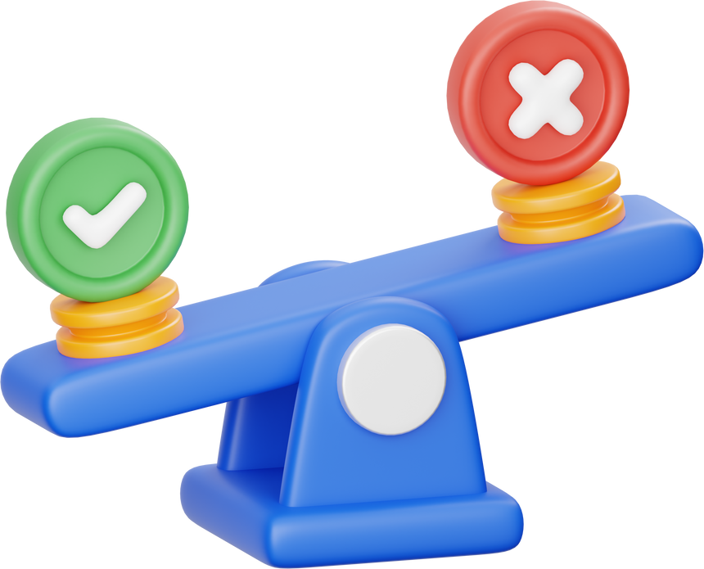
The Problem
Student
System
Present by: LM Yudhy P

Slide 7
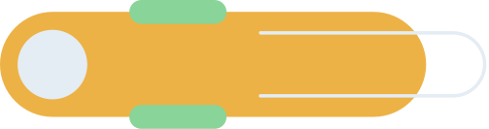


Cheating
Cheating Online
Online cheating is cheating done by utilizing technology or the internet to gain an unfair advantage. An example is cheating on an online exam by searching for answers on the internet.
Cheating Offline
Offline cheating is cheating that is done without the use of technology or the internet, but rather directly or manually. Examples are bringing cheats during exams, working with friends to copy answers.
Present by: LM Yudhy P

Slide 8
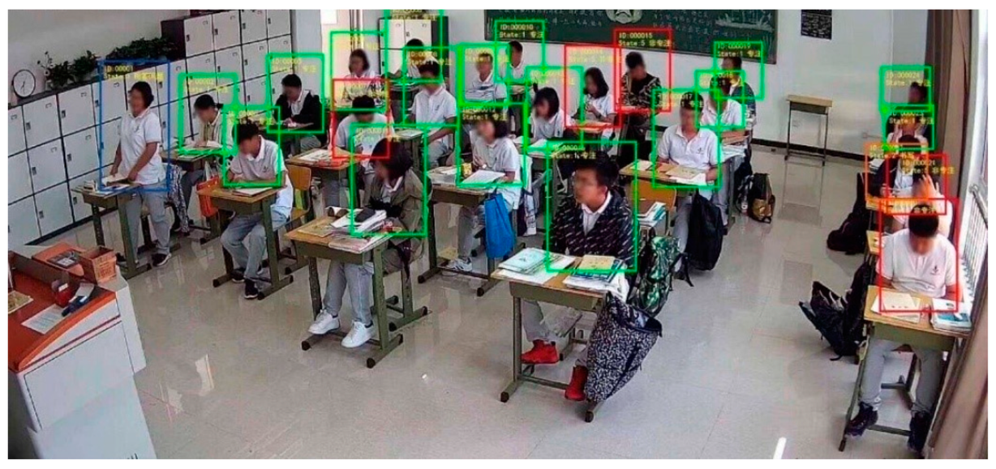
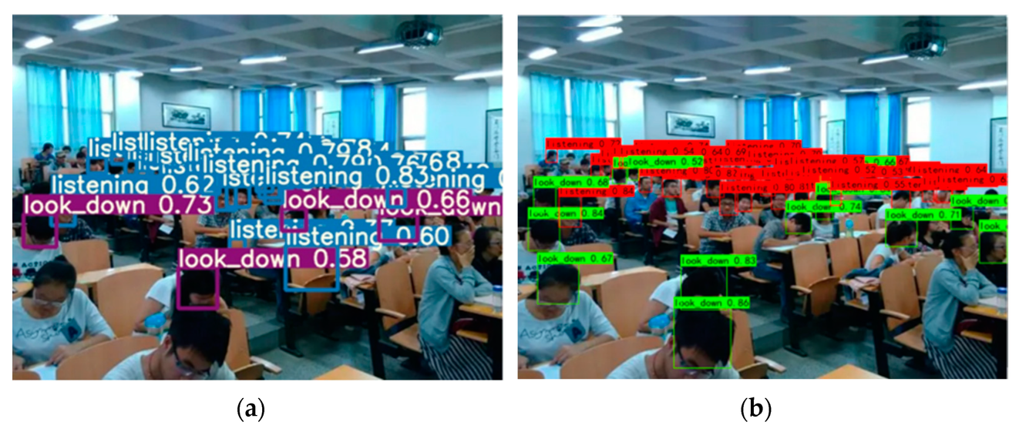
Object detection
Object detection is a computer vision task that goes beyond simply classifying an image; it identifies and locates multiple objects within an image, assigning them precise bounding boxes and categories.
Object detection in a classroom context involves using computer vision techniques to identify and locate objects (like students, desks, or blackboards) within images or videos of a classroom
Present by: LM Yudhy P

Slide 9

INTRODUCTION TO
EDU VIEW
EDUVIEW
Deep Learning 2025
Present by: LM Yudhy P

Slide 10


Universitas Halu Oleo
Real-Time Object Detection for Student Cheating in
a Classroom Using YOLO
MODEL 1
Maret, 2025
Present by: Dwi Pratiwi Aprilya Wahid

Slide 11
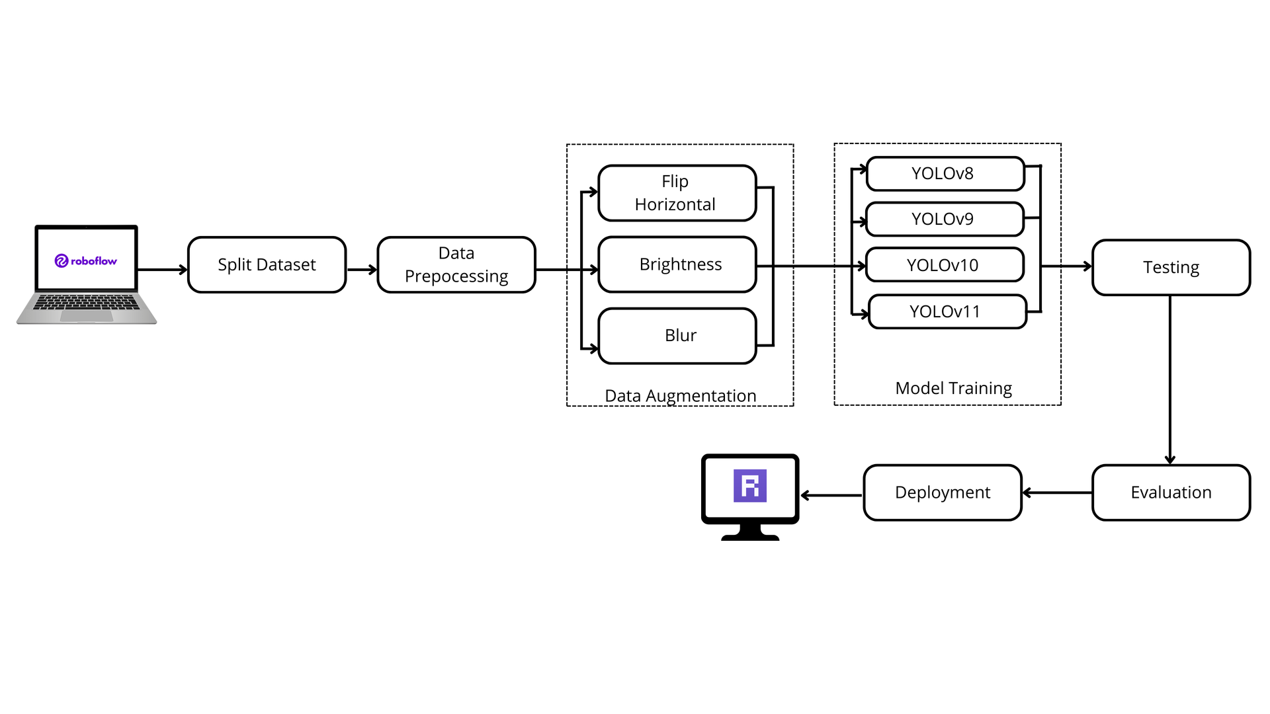
Work flow
Present by: Dwi Pratiwi Aprilya Wahid

Slide 12
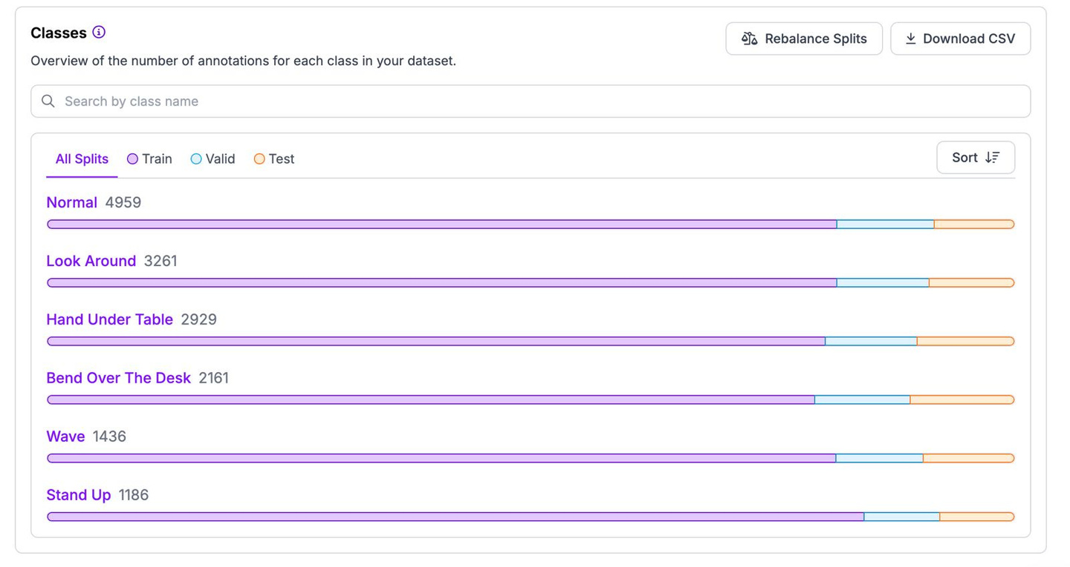
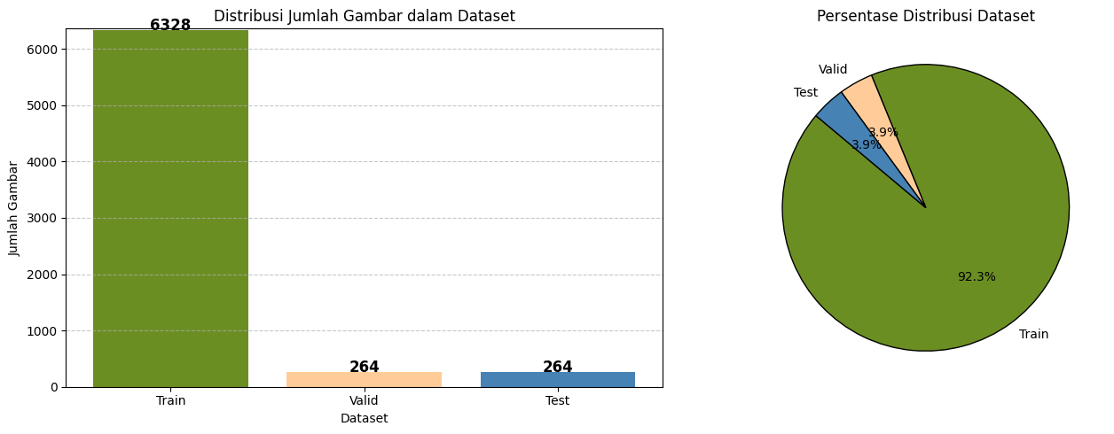
Dataset
Present by: Icha anawai

Slide 13
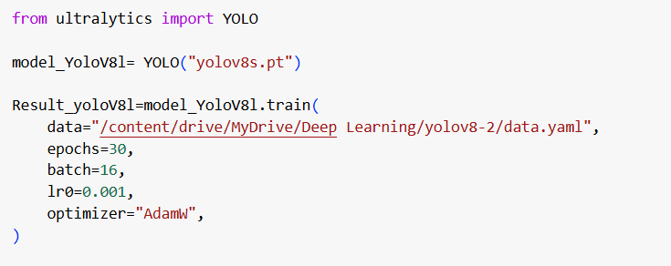
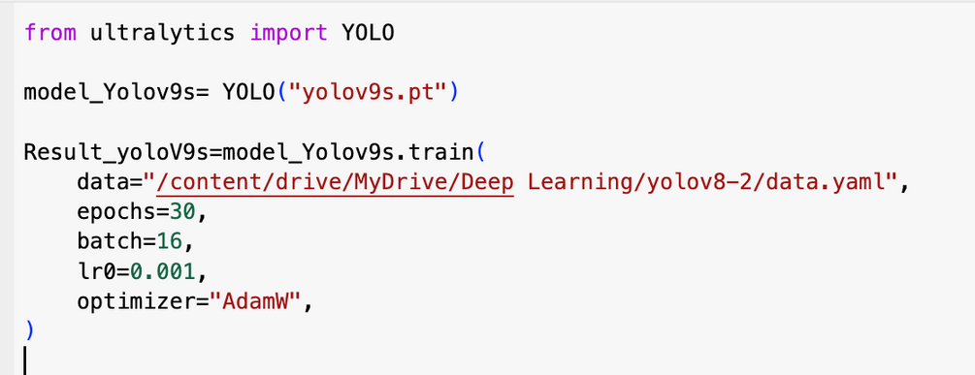
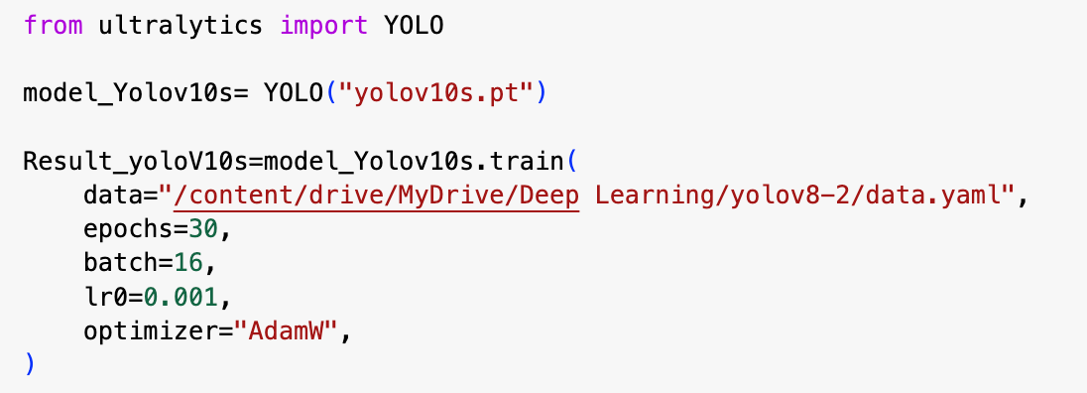
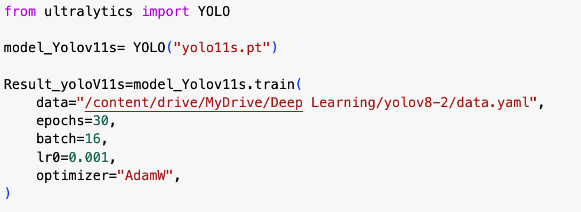
Model Training
Present by: Icha Anawai

Slide 14
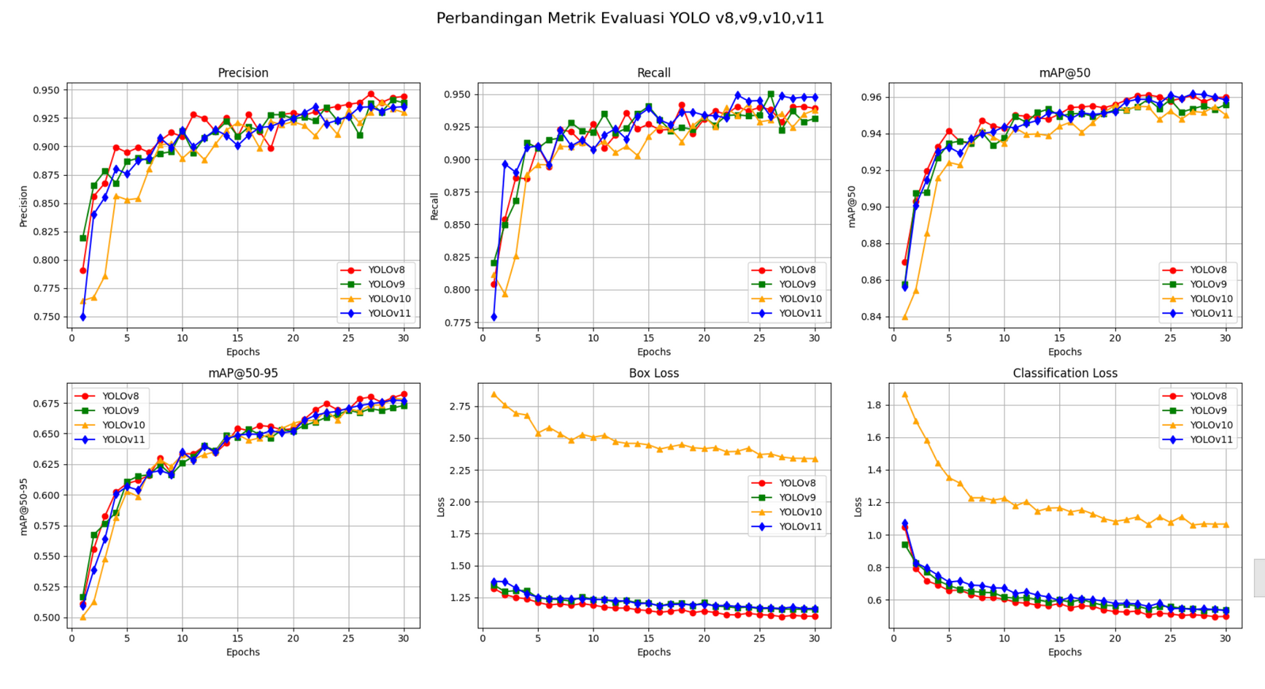
Comparison of Model Evaluation Metrics
Present by: Dwi Pratiwi Aprilya Wahid

Slide 15
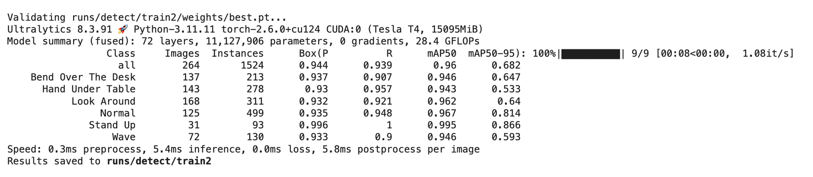
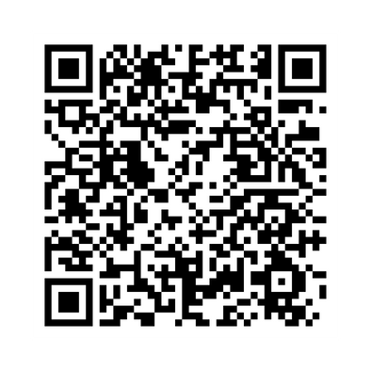
Accuracy
QR-CODE
Present by: Dwi Pratiwi Aprilya Wahid

Slide 16
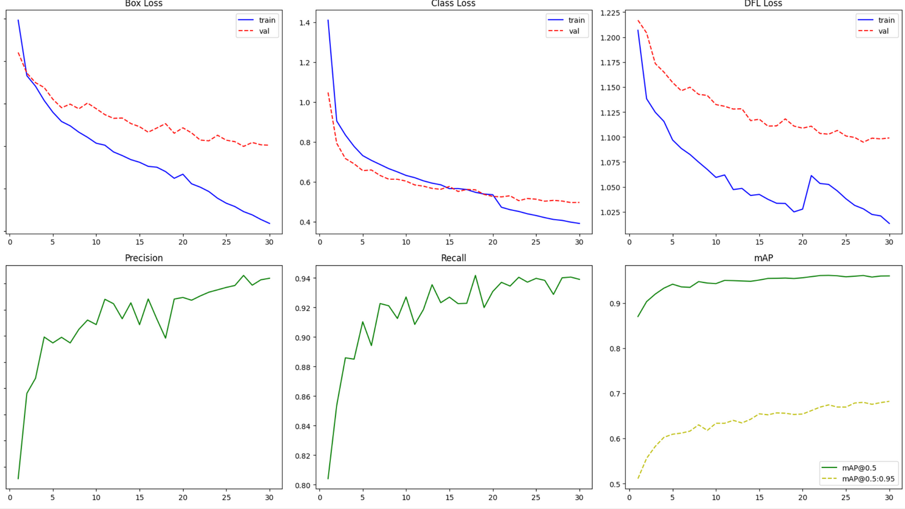
Training Metrics Plot Yolov8s
Present by: Dwi Pratiwi Aprilya Wahid

Slide 17
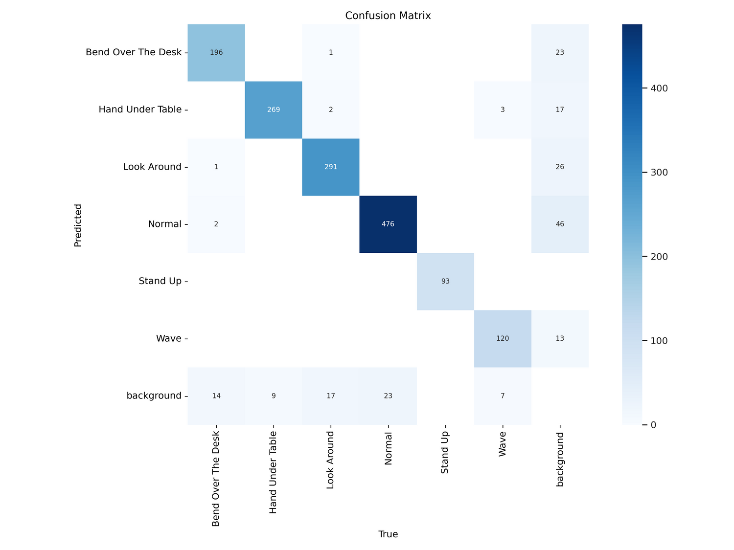
CONFUSION MATRIX
Present by: Icha anawai

Slide 18
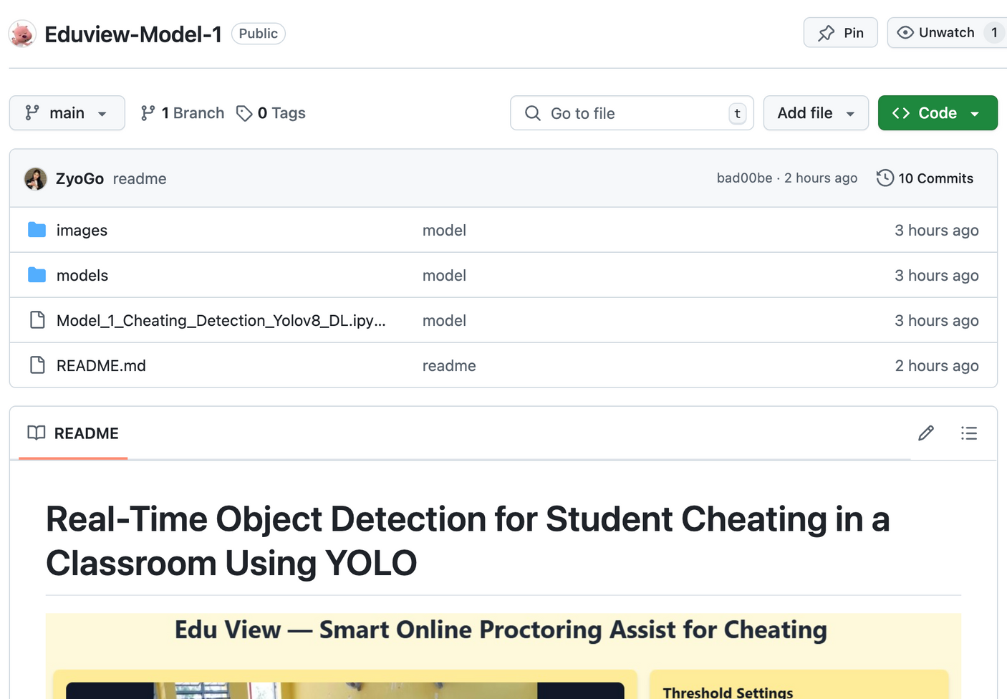
Repository Github
https://github.com/dwipratiwiy/Eduview-Model-1/tree/main

Slide 19
Universitas Halu Oleo
Head Movement Tracking and Object Recognition
for Preventing Cheating in Online Exams Using YOLO
MODEL 2
Maret, 2025
Present by: Fikry Haykal

Slide 20
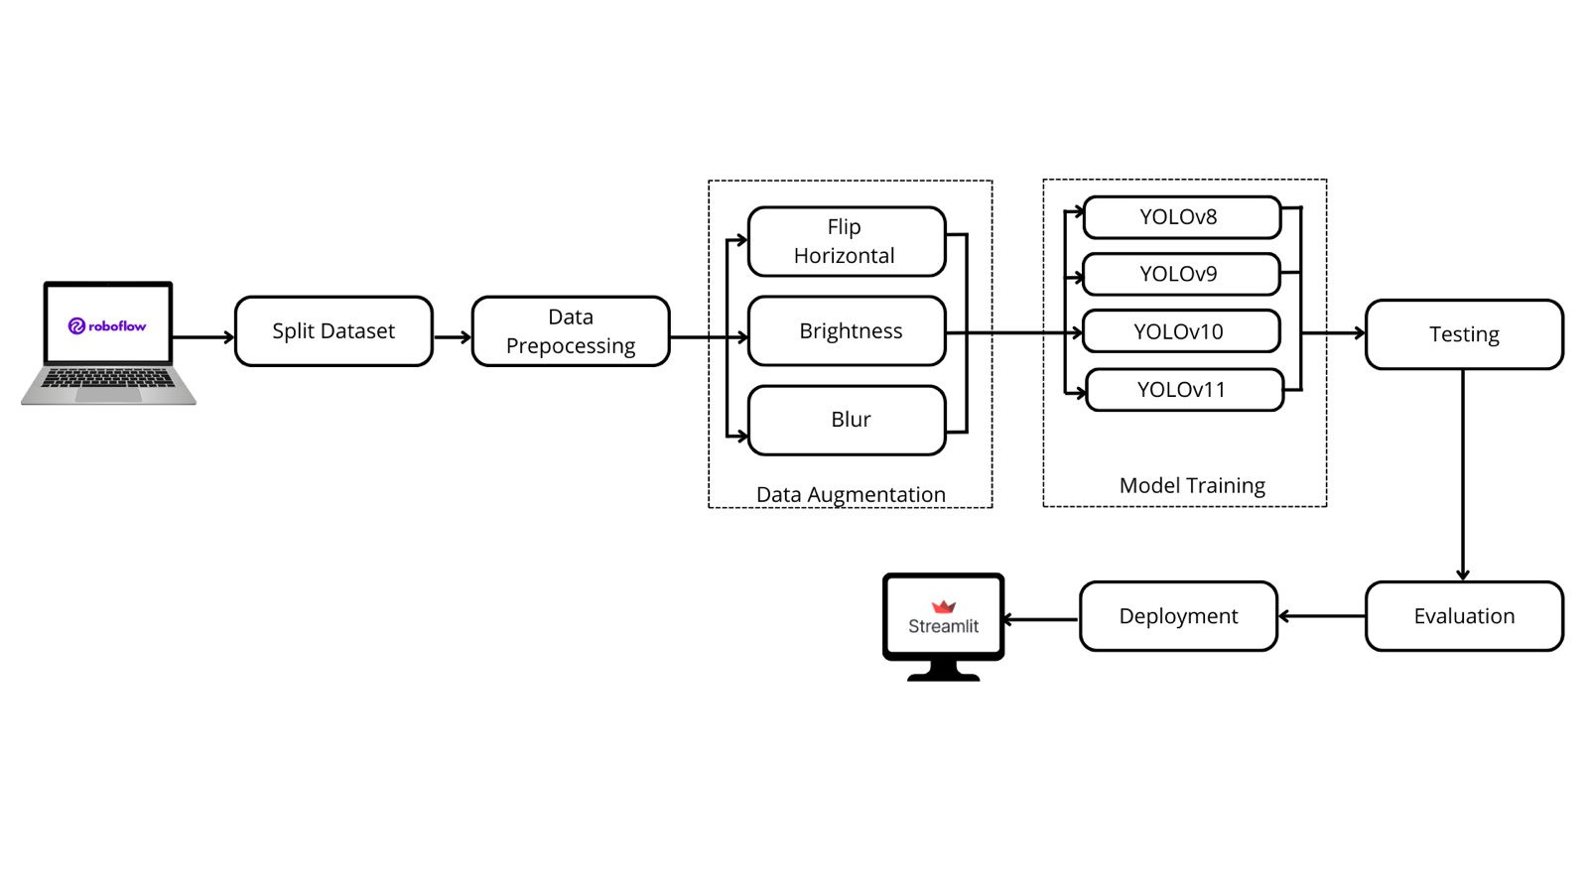
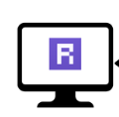
work flow
Present by: Fikry Haykal

Slide 21
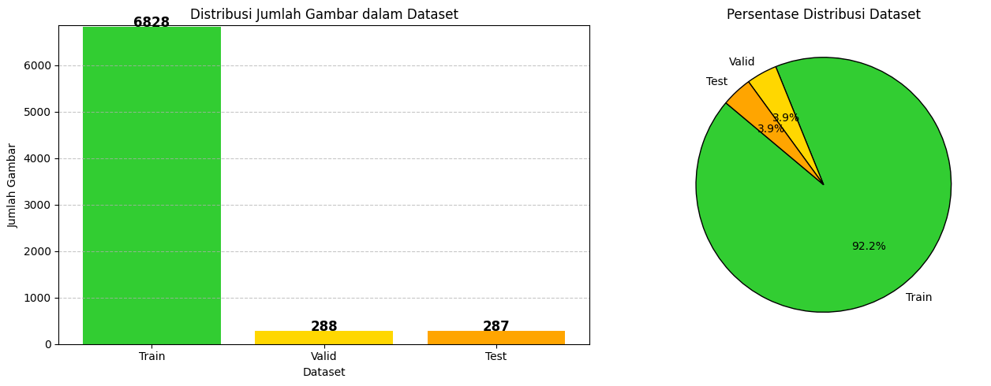
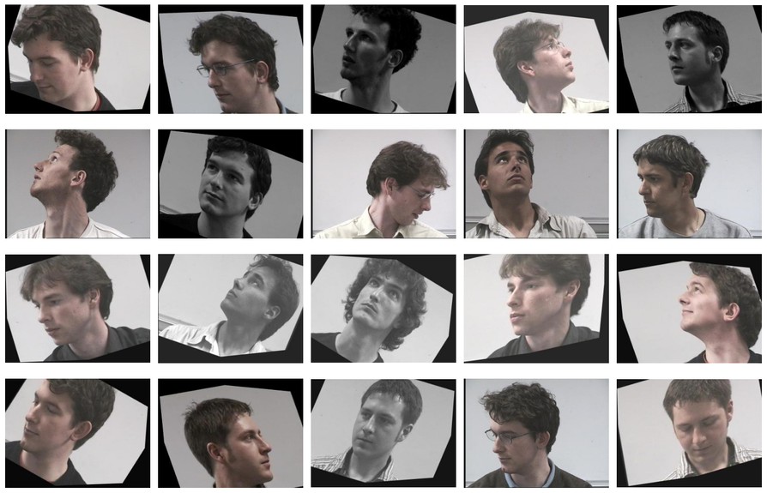
dataset (augmentasi)
Present by: Sumiarni Moka

Slide 22
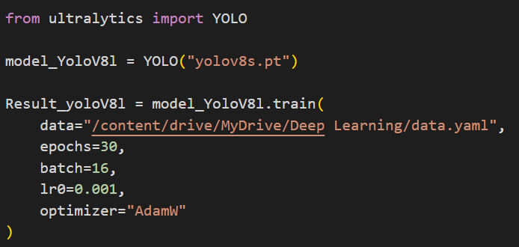
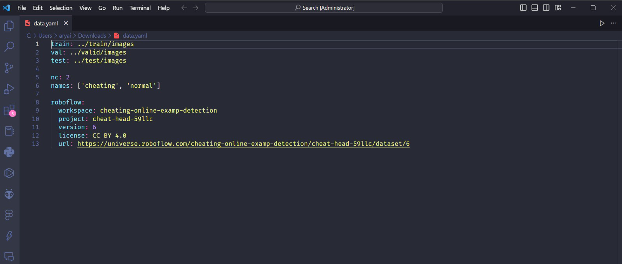
code
Present by: Arya Dwinata Mustapa

Slide 23
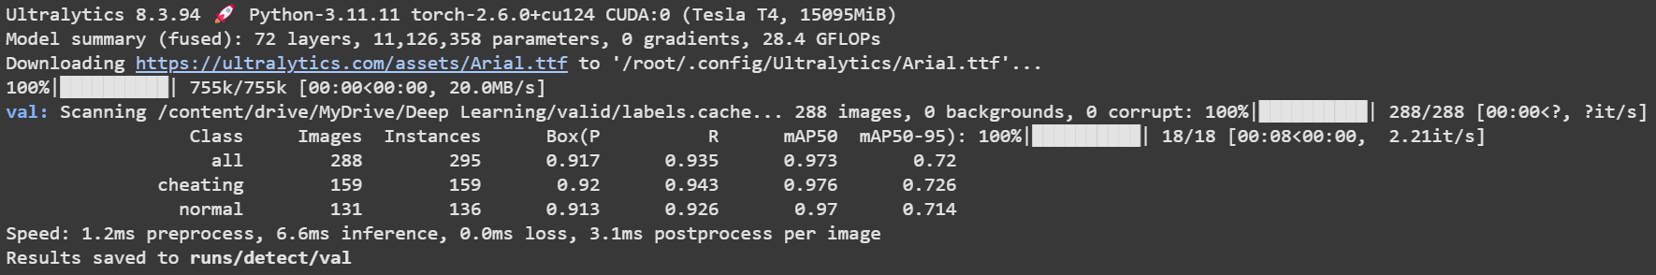
Akurasi
Present by: Arya Dwinata Mustapa

Slide 24
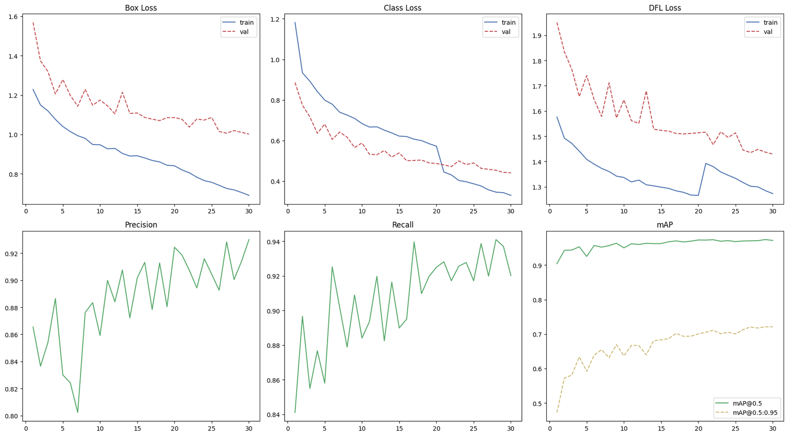
training matrics plot
Present by: Arya Dwinata Mustapa

Slide 25
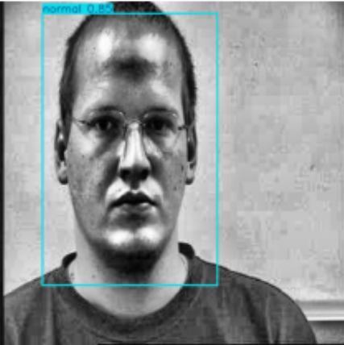
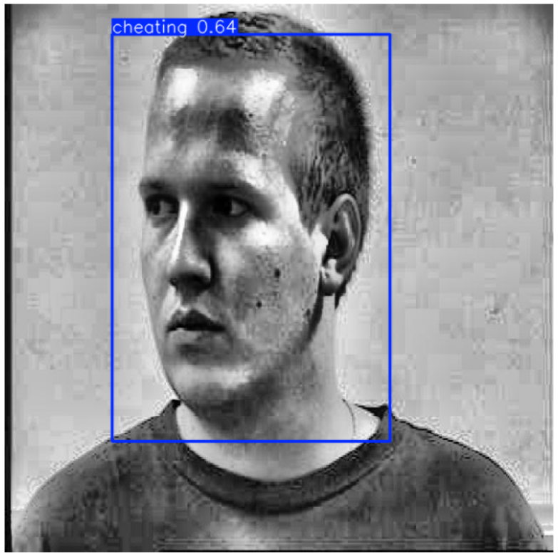
oUTPUT
Present by: Arya Dwinata Mustapa

Slide 26
Universitas Halu Oleo
Eye Activity Analysis for Silent Cheating
Detection in Online Exams Using cnn
MODEL 3
Present by: Nuzul

Slide 27
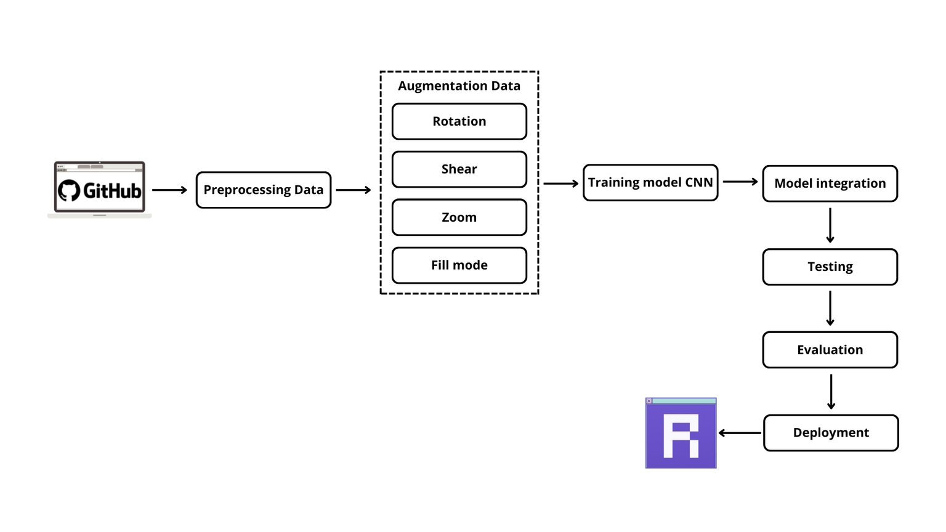
WORKFLOW
Present by: Nuzul

Slide 28

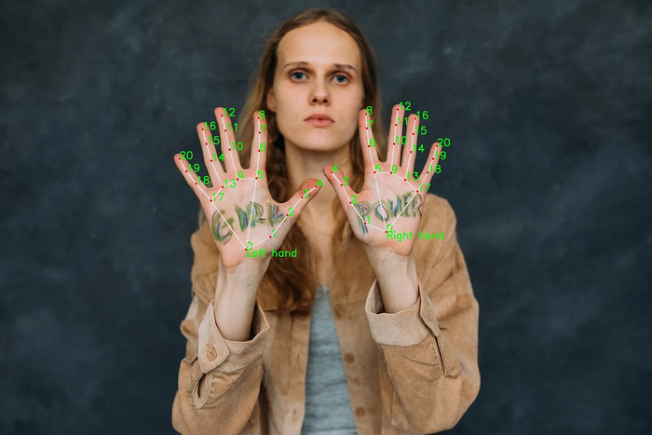
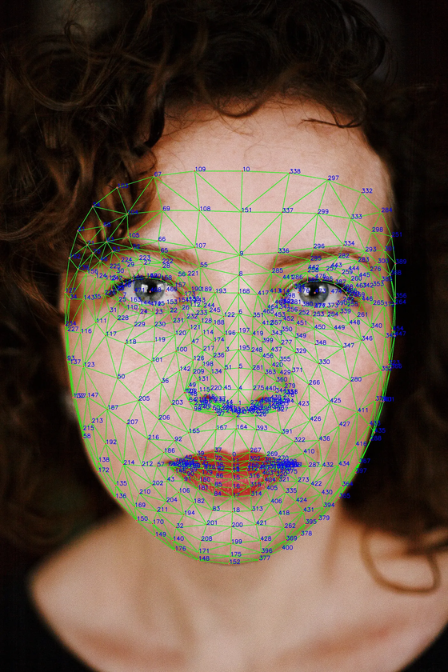
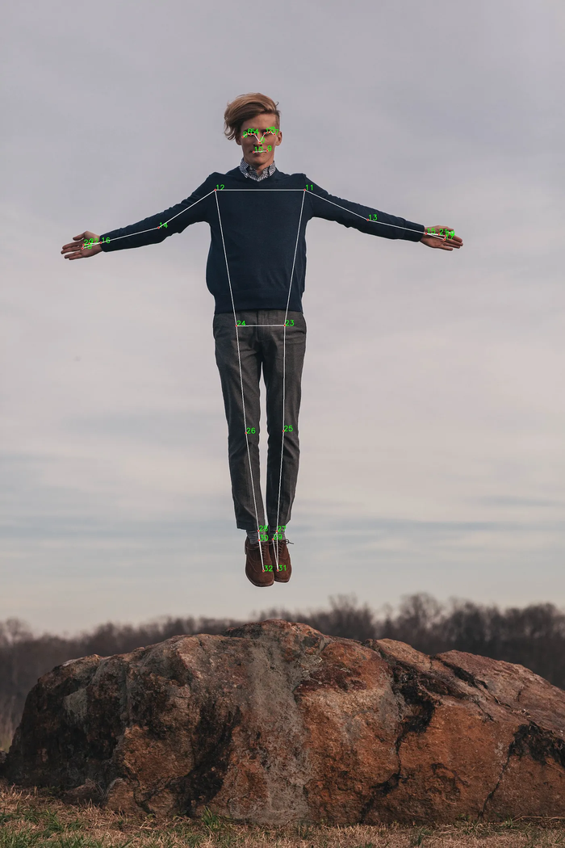
Mediapipe
Hand skeleton
Face mesh
Pose (Body)
MediaPipe is an open-source framework for building pipelines to perform computer vision inference over arbitrary sensory data such as video or audio. Using MediaPipe, such a perception pipeline can be built as a graph of modular components.
Present by: Nuzul

Slide 29
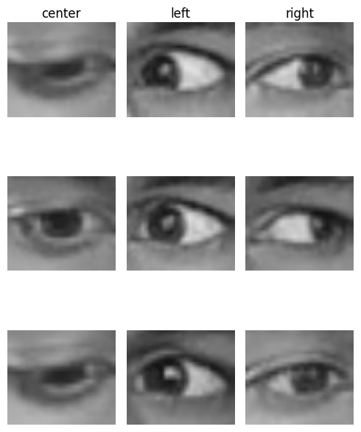
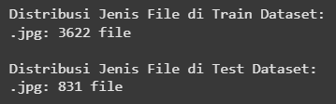
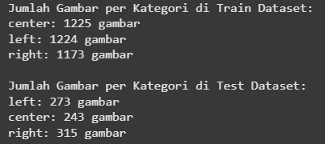
DATASET
Present by: Sherly

Slide 30
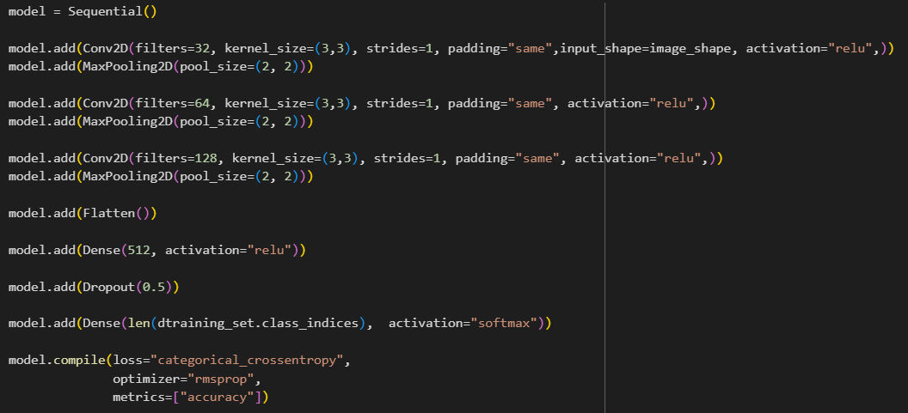
CODE
Link code
Present by: Alvin

Slide 31
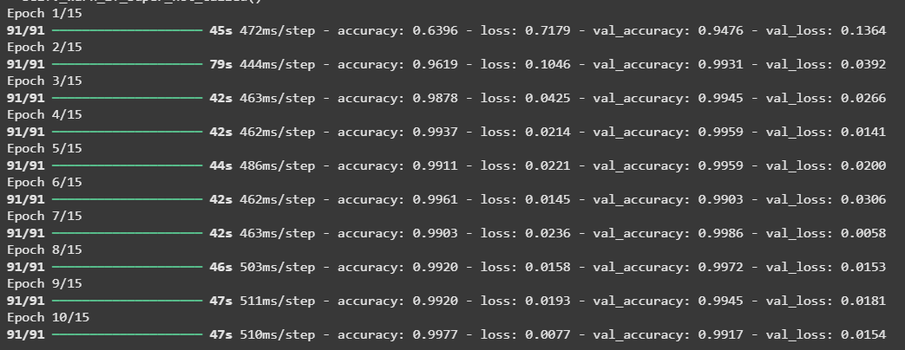
RESULT
Present by: Artientin

Slide 32
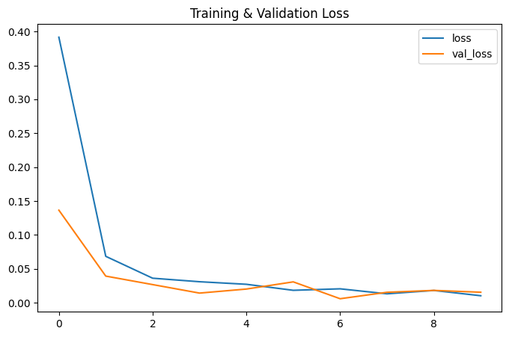
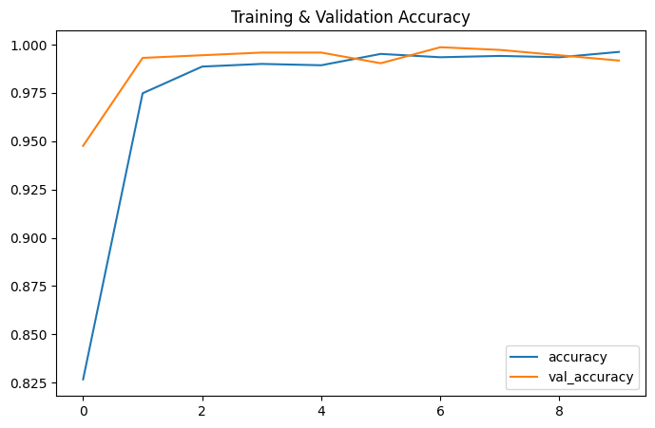
RESULT
Present by: Artientin

Slide 33
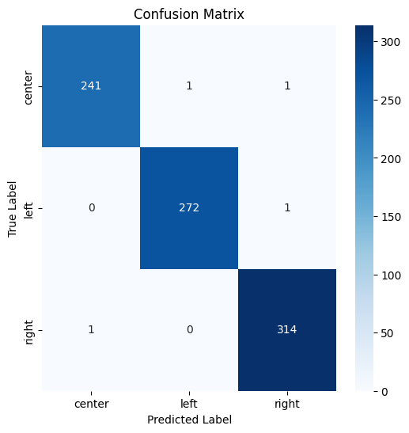
CONFUSION MATRIX
Present by: Artientin

Slide 34
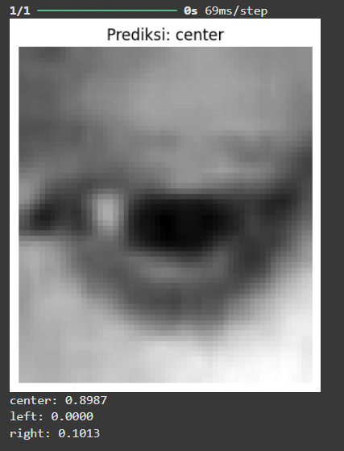
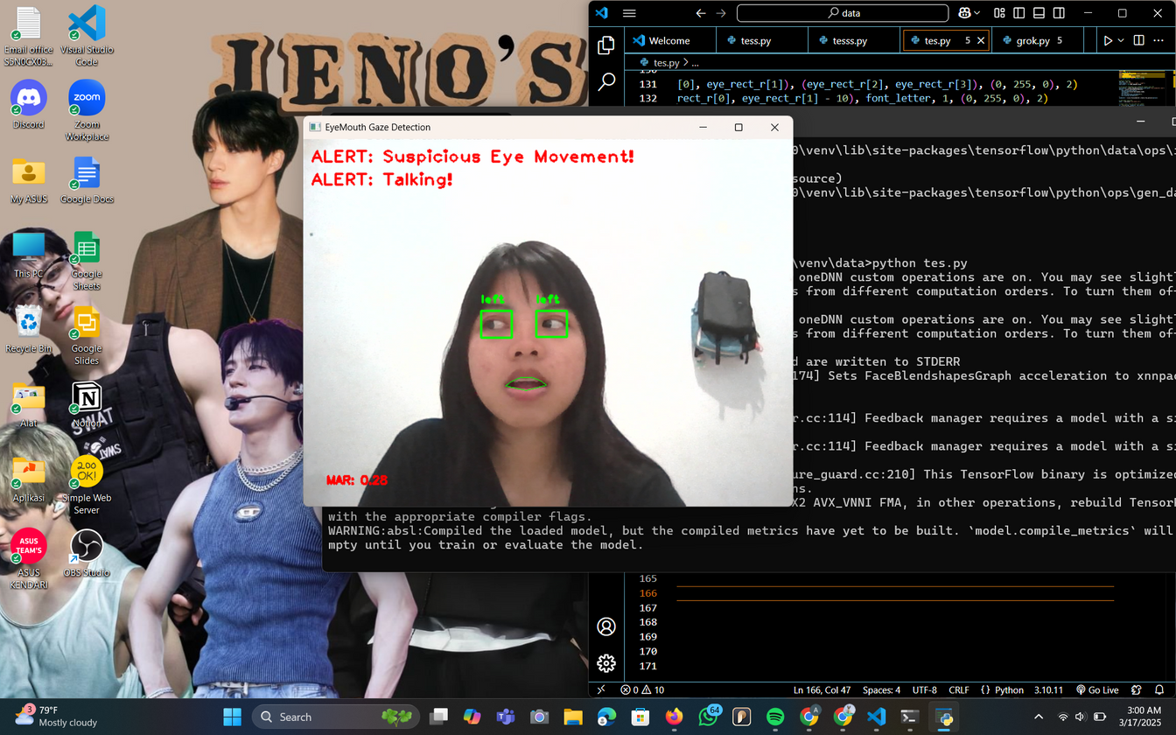

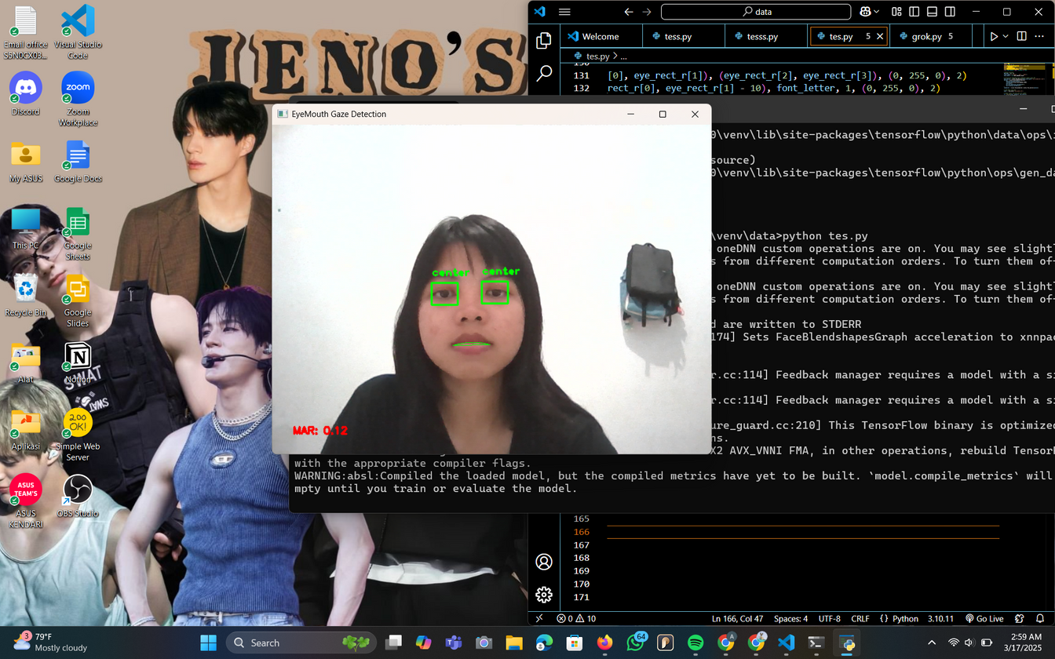
TEST MODEL
Present by: Artientin

Slide 35
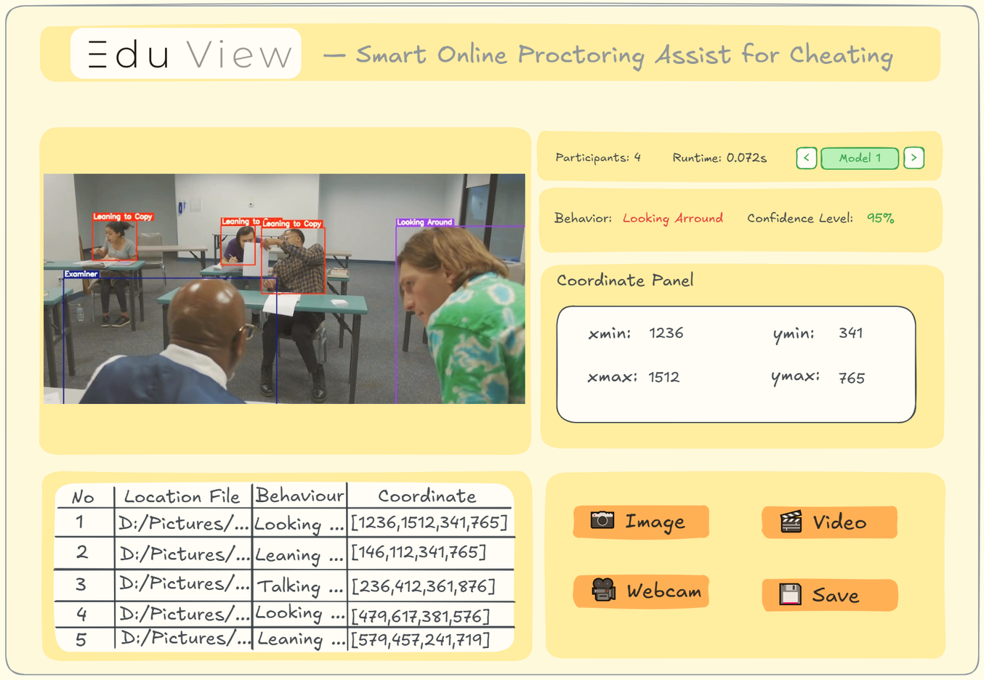

DESAIN APP WEB
Present by: LM Yudhy P

Slide 36
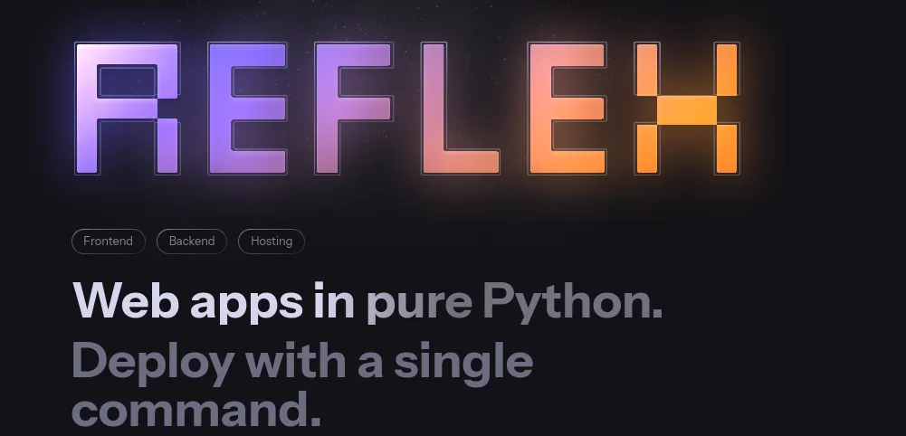


Front End & Back End
Reflex is an open-source framework for quickly building beautiful, interactive web applications in pure Python
Present by: LM Yudhy P

Slide 37


Testing Web App
Present by: LM Yudhy P

Slide 38



Testing Web App
Present by: LM Yudhy P

Slide 39


Testing Web App
Present by: LM Yudhy P

Slide 40

Repository Github
https://github.com/Laoode/EduView/tree/model2-testingtext
Present by: LM Yudhy P

Slide 41
Universitas Halu Oleo
Thank You

